Slide 1
Enhancing Higher Education with HP Poly Audio and Video Solutions
Transforming classrooms and student enrichment with innovative technology
Notes:
-
This presentation highlights how HP Poly's innovative audio and video solutions can transform higher education. We will explore the features and benefits of these technologies that support effective teaching and learning in today's classrooms.

Slide 2



Slide 3
Where collaboration solutions are needed in Higher Education
Remote students
MBA Program
Virtual Classes
Distance education
Peer Consulting
Interviews
Team Activities
Student communications
Office Hours
Tutoring
Remote Experts
Lecture Capture
Faculty-student enrichment
Faculty Learning
Policy Training
Peer Training
Continuing education
Day-to-day business
HR
Admissions Board Finance
Marketing
PR
Alumni Reach
HP Confidential. For use by HP or Partner with Customers under HP CDA only

Slide 4
Introduction to HP Poly Solutions
Notes:
HP Poly offers cutting-edge audio and video solutions designed specifically for educational environments. These tools are crafted to enhance communication, collaboration, and engagement in K-12 settings.

Slide 5
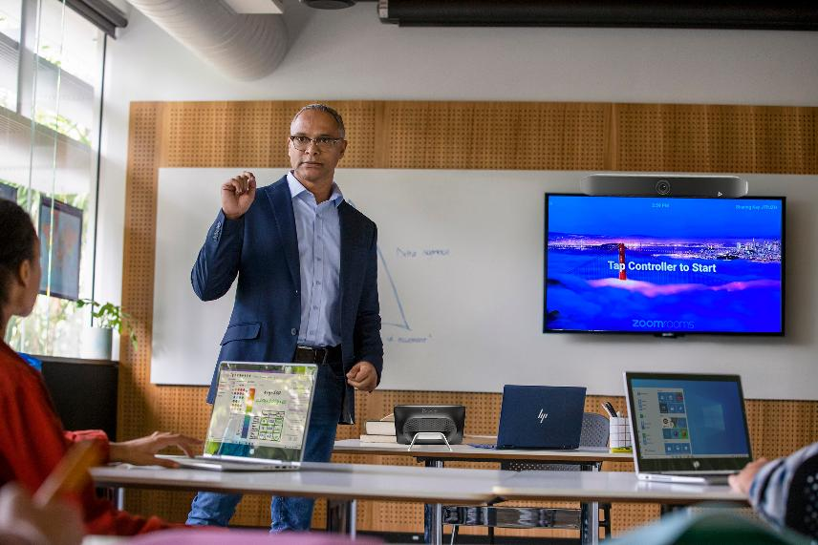
Overview of HP Poly Products
Phones
  HP Poly offers high-quality phones both wired and wireless which fit perfectly in educational settings, that are ideal for security and communication.
  Headsets
  The range of headsets from HP Poly offer students, administration and faculty a wide range of options to ensure easy listening and communicating from different environments.
  Video Conferencing Solutions
  HP Poly provides comprehensive video conferencing systems that facilitate seamless audio-visual interaction in educational settings.
HP Confidential. For use by HP or Partner with Customers under HP CDA only
Notes:
HP Poly products are tailored to meet the unique demands of educational settings, ensuring effective audio and visual interaction.

Slide 6
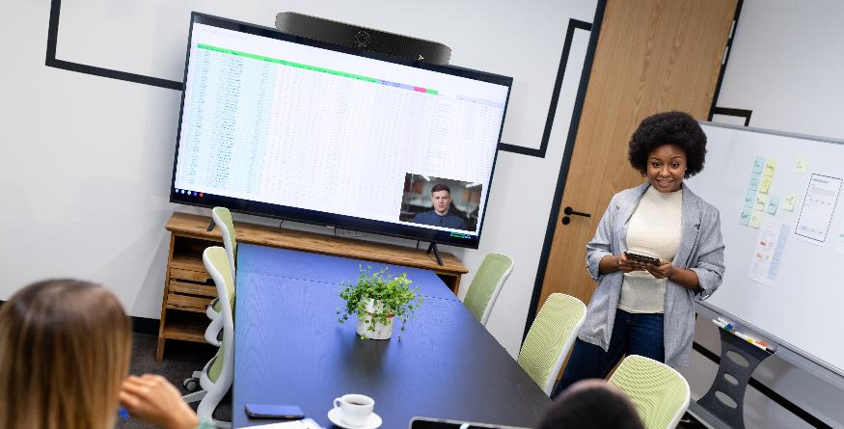
Benefits in the classroom and administration
Enhanced Student Engagement
  Audio and video solutions can capture students' attention and motivate them to participate actively in lessons.
Improved Communication
  These solutions facilitate better communication between instructors and students, creating a more collaborative learning environment.
Administrative Enhancements
  With audio and video tools, administration can effectively participate in remote trainings, community broadcasts, HR activities and more.
HP Confidential. For use by HP or Partner with Customers under HP CDA only
Notes:
Integrating audio and video solutions in education can significantly enhance the learning experience. Benefits include improved student engagement, better communication, and the ability to conduct interactive lessons.

Slide 7
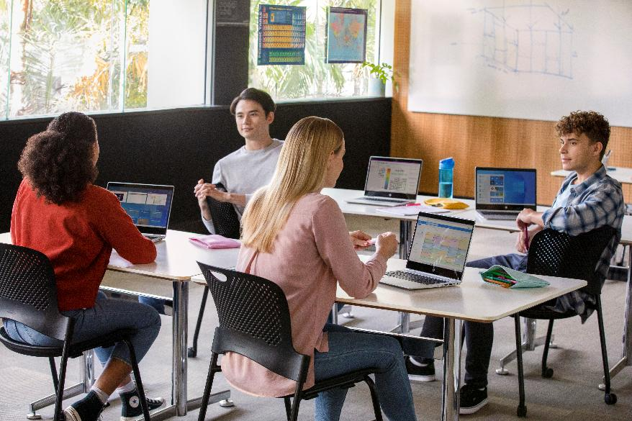
HP's Commitment to Educational Technology
Innovative Tools for Learning
  HP provides schools with innovative educational tools designed to enhance student learning and engagement in the classroom.
Fostering Collaboration
  Technology promotes collaboration among students, enabling them to work together effectively and share ideas.
Inclusivity in Education
  HP's commitment includes ensuring that educational technologies are accessible to all students, fostering inclusivity.
HP Confidential. For use by HP or Partner with Customers under HP CDA only
Notes:
HP is dedicated to advancing educational technology, providing schools with innovative tools that foster collaboration and inclusivity in the classroom. Their commitment ensures that educational institutions have access to the latest advancements.

Slide 8

Chapman University
  CHALLENGE
Multi-campus environment where student and faculty collaboration needed to be improved
  SOLUTION
HP Poly Solutions include speakerphones, headsets, G Series and Studio X solutions. Video solutions provisioned in either Zoom or Microsoft TEAMS
  BENEFITS
Applications grew well beyond connecting campuses
Top candidates for both faculty and students are now able to have direct reach into university
Alumni interaction has grown significantly
Instructors have increased remote office hours
Additional courses are offered
  “Our charter is to provide a personalized education; this technology helps deliver on that…”
Phillip Lyle
Assistant Vice President,
Enterprise & Research Infrastructure
Information Systems & Technology
HP Confidential. For use by HP or Partner with Customers under HP CDA only.
Notes:
A perfect example of a school that has embraced Poly solutions in their existing ecosystem is Chapman University.
They use multiple cloud services from Zoom, Office 365 and others.
Poly works alongside or fully-integrated into these.

Slide 9
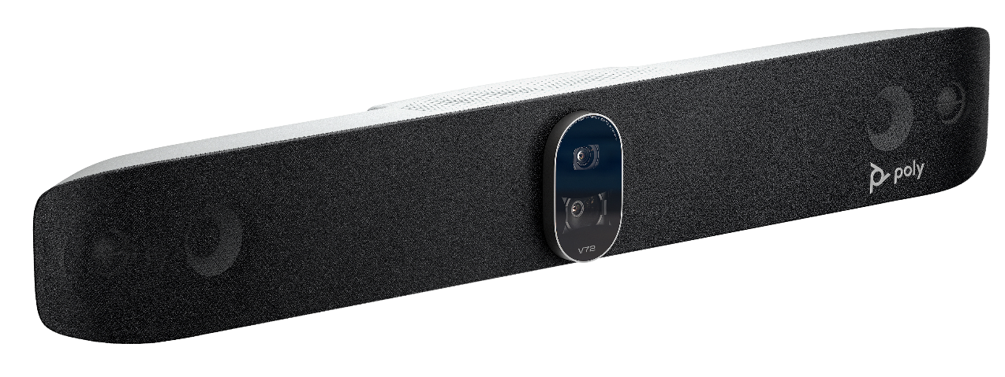
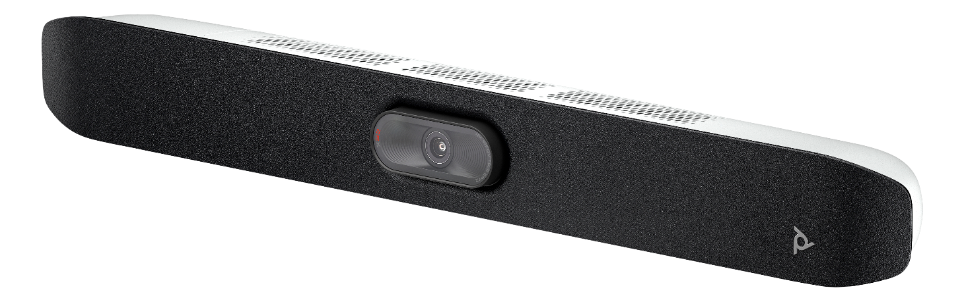
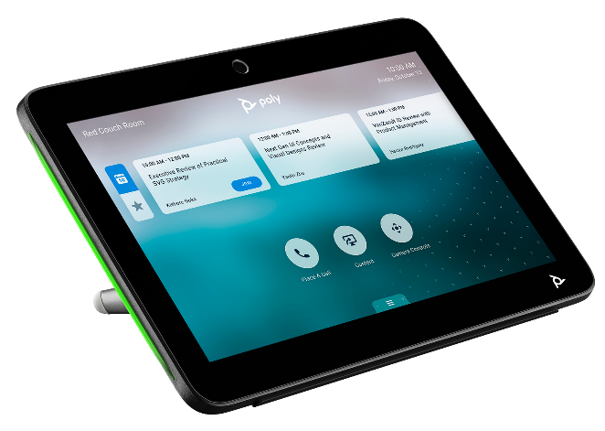
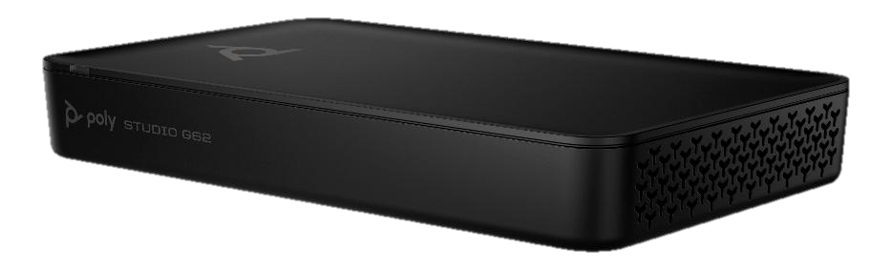
HP | Poly Education Video Solutions
Delivering in-person quality over distance.
HP Confidential. For use by HP or Partner with Customers under HP CDA only
Notes:
Now let’s dive into the HP | Poly classroom and meeting space solutions.
As a leader in audio and video innovation, our focus is on delivering seamless collaboration experiences built for today’s hybrid teams.

Slide 10
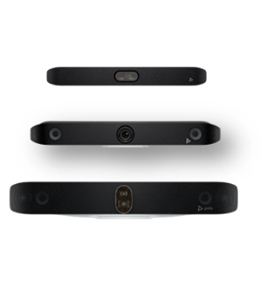
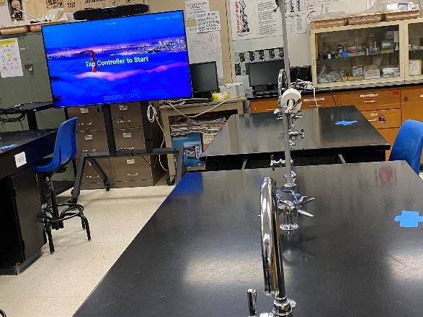
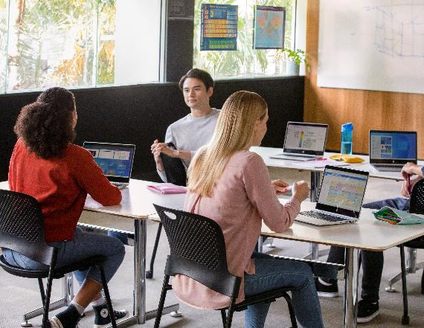
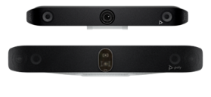
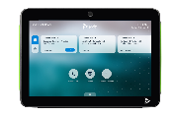
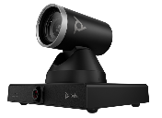
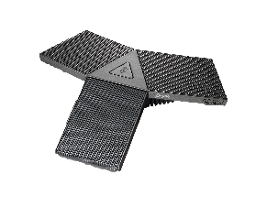
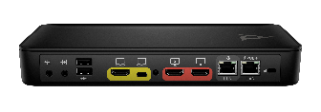
Comprehensive and flexible video portfolio
HP | Poly offers an extensive portfolio of solutions
A single provider simplifies the experience
Driving consistency for today, flexibility for the future
HP Confidential. For use by HP or Partner with Customers under HP CDA only

Slide 11
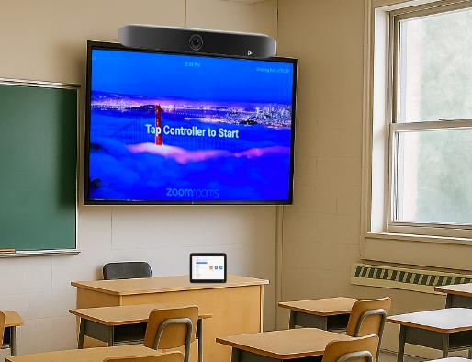
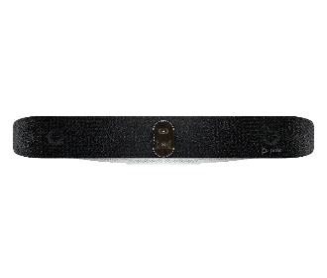
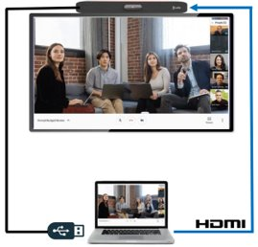
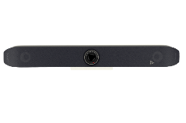

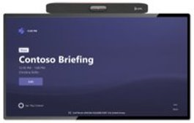
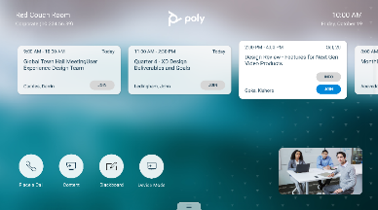
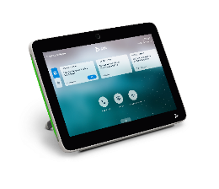




Platform flexibility to future-proof your collaboration
Built-in cloud video apps
Native full-featured experience.
Open SIP
Enables flexibility for environments requiring customization, interoperability, or enhanced security.
BYOD or Device Mode
Extends any cloud video platform from a laptop to a room system.
HP Confidential. For use by HP or Partner with Customers under HP CDA only

Slide 12
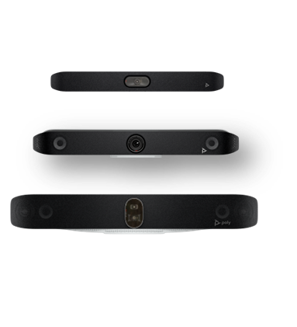

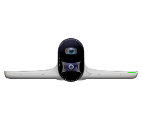

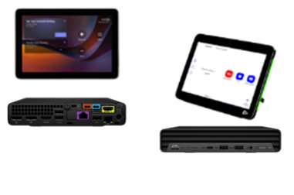
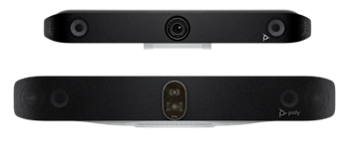


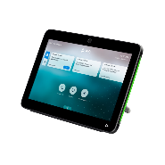
HP | Poly offers an extensive portfolio of solutions
All-in-one Video Bars
USB Video Bars
Windows-Based Modular
Android-Based Modular
Accessories
Poly Studio X-series
Poly Studio V-series
Cameras
Microsoft and Zoom kits
Poly Studio G62
Microphones
Windows-based kits for rooms of all sizes running Microsoft Teams or Zoom*.
Modular solutions with
peripherals for customized collaboration spaces.
Touch Controller
All-in-one video solution
- no PC or Mac required.
Premium, powerful
solutions for PC room kits or BYOD use cases.
Solutions for any room size, OS, solution type, and video platform -- all built, sold, and supported by HP.
*Zoom Rooms license is required and sold separately. Microsoft teams license required and sold separately.
HP Confidential. For use by HP or Partner with Customers under HP CDA only

Slide 13
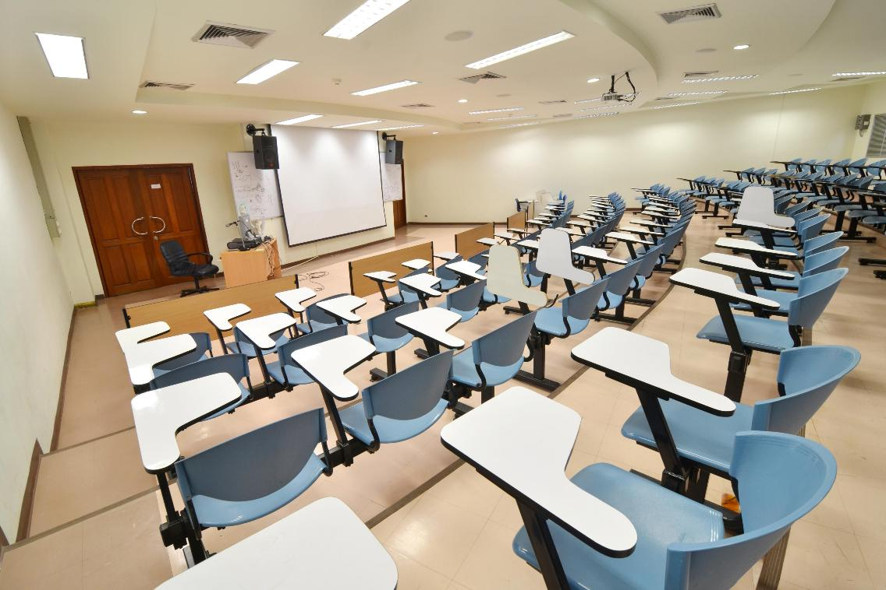
Exceptional vocal clarity
Ideal for classroom environments, highly sensitive microphones in video bars and external mics capture voices with remarkable precision, delivering an “in-the-same-room” experience.
Patent protected 2nd order gradient microphones (found in Poly Studio X52, Poly Studio V52, Poly Studio X72, Poly Studio V72) attenuates sounds, noise, and room reflections.
Hearing augmentation for listening devices available on Poly Studio X52.
HP Confidential. For use by HP or Partner with Customers under HP CDA only
Notes:
When it comes to remote classroom connections, being heard clearly is very important.
Our solutions deliver exceptional vocal clarity through highly sensitive microphones, whether built into our video bars or used externally. They capture voices with incredible precision, helping remote participants feel like they’re right there in the room.
We’ve also engineered something truly unique: patent-protected second-order gradient microphones. These advanced mics help reduce background noise, echo, and room reflections—so voices come through clearly, even in challenging acoustic environments.

Slide 14
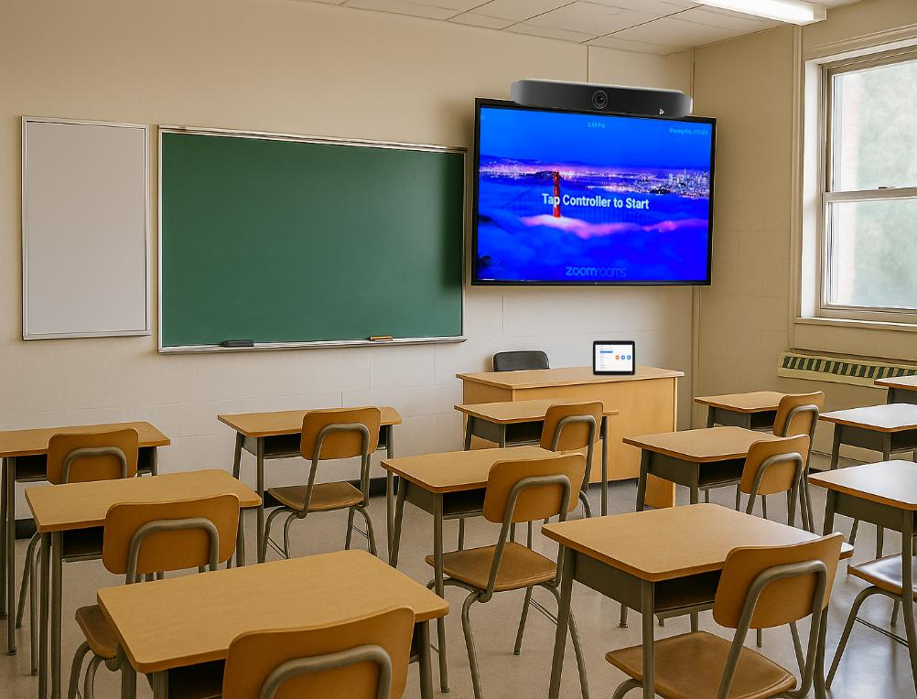








Poly audio technologies
Removes distractions to provide a focus that fuels collaboration and education
Poly NoiseBlockAI
Uses advanced AI and machine learning to identify and block distracting noises and reverberation* for a seamless call experience.
Typing and Clicking
Dog
Barking
HVAC
System
Reverberation
Loud Eating or
Drinking
Hallway Conversations
Poly Acoustic Fence
Creates an invisible audio fence during calls that reduces voices and noise outside of a zone so that your voice is heard with clarity.
chip
*Reverberation removal available on select devices
HP Confidential. For use by HP or Partner with Customers under HP CDA only
Notes:
Clear communication isn’t just about great microphones, it’s also about what happens after your voice is captured.
Poly audio technologies work behind the scenes to remove distractions for the far end and deliver a more focused, productive call experience.
Poly NoiseBlockA uses advanced AI and machine learning to recognize and block background noises, like keyboard typing, paper shuffling, HVAC hum, or reverberation. It was a cutting-edge technology when first introduced, and we continue to enhance it for an even better experience.
Poly Acoustic Fence creates an invisible audio boundary around the meeting space that focuses on the voices within that zone. It eliminates the need to constantly mute and unmute, since hallway chatter won’t interrupt your call or cause confusion. This innovative software is unique to Poly, and you won’t find anything like it from other providers.
Together, these technologies help keep everyone focused on the conversation.

Slide 15
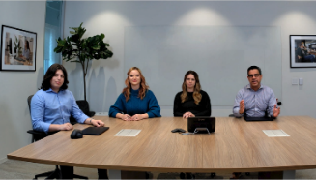
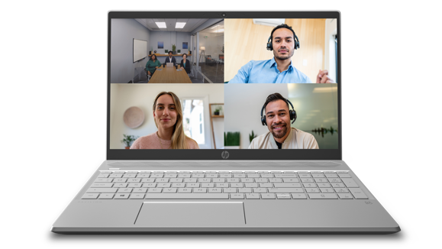

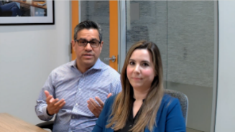

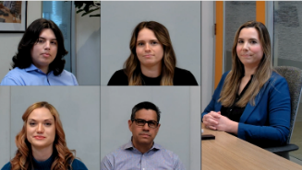
Smart camera technology
Poly DirectorAI creates the most equitable experience in the classroom or meeting room
Choose between automatic framing modes
Enhance the experience
Group framing
Poly DirectorAI Perimeter
Set the meeting room dimensions to keep your meeting focused and distractions at bay.
Speaker framing
Perimeter Off
Perimeter On
People framing
Presenter tracking available on Poly Studio E60
HP Confidential. For use by HP or Partner with Customers under HP CDA only
Notes:
To help bridge the gap between in-room and remote participants, we’ve developed a powerful set of AI-driven camera capabilities.
With Poly DirectorAI smart camera framing, the system intelligently identifies and frames participants, automatically adjusting the view as people enter, leave, or move around the room. Users can choose the framing mode that fits their meeting, creating a more natural and engaging experience for remote attendees.
Poly DirectorAI Perimeter enhances the experience by letting admins set the meeting room dimensions. This keeps the meeting focused only on participants inside that space, minimizing distractions from hallways or through glass walls.

Slide 16
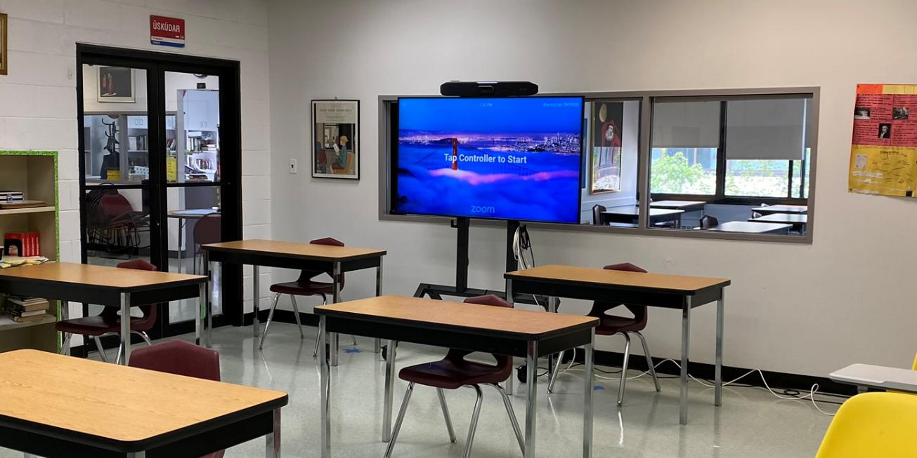
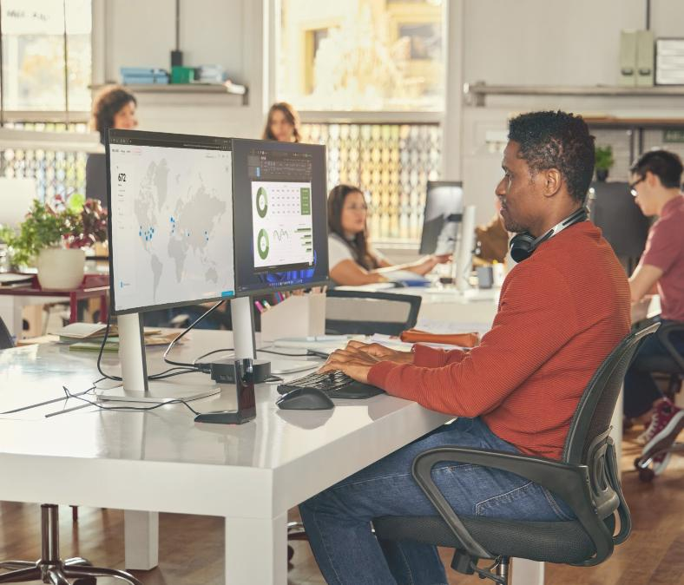
Poly Lens management and insights
Remotely deploy, manage & update through centralized policies at scale
Proactive alerts ensure system uptime
Remote troubleshooting and¹ control of devices
“Classroom insights provide utilization and occupancy metrics
Visibility to the entire room
*Integration across platforms such as Zoom Device Management, Microsoft O365 Calendaring, Power BI
All your rooms, devices, and user accounts from one admin portal
HP Confidential. For use by HP or Partner with Customers under HP CDA only
*Requires Poly Lens Pro for Rooms license.
Notes:
Poly Lens software provides collaborative experiences and business outcomes through device management and room insights. IT departments can remotely inventory, control, monitor, and troubleshoot devices while measuring success through their private cloud portal. End users have access to an app built for their personal collaborative devices, helping keep webcams and headsets updated while personalizing the experience.

Slide 17
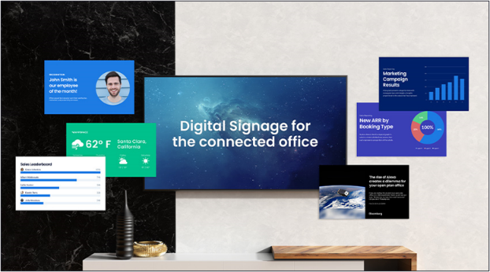



Digital Signage
Get the most from your monitors throughout campus.
DIGITAL SIGNAGE¹
Enable digital signage to provide more value out of your video solution investment. Provide up-to-date school information, weather and security information quickly throughout the campus.
HP Confidential. For use by HP or Partner with Customers under HP CDA only.
Notes:
¹ A subscription to a digital signage provider is required and not sold by HP.

Slide 18
HP Poly Voice Solutions
Notes:
In addition to audio, HP Poly's video solutions are pivotal for modern classrooms, offering high-quality visual experiences that support learning.

Slide 19
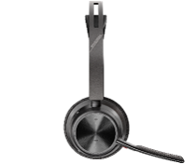
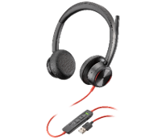
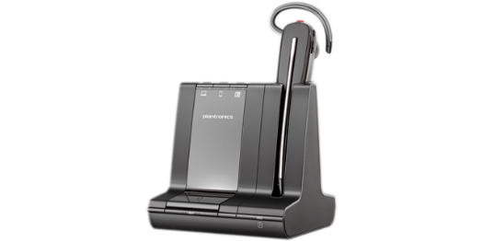
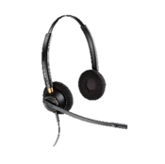
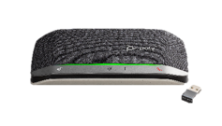
Headsets & Speakerphone Families
Voyager
Blackwire
Sync
Savi
EncorePro
Wireless Bluetooth headsets
DECTTM wireless headsets
Wired headset for wide distribution
Wired headsets
Speakerphone
Crystal clear sound no matter where you are
Wearing style options
Perfect for hybrid work
Mobile first with office options
Easy use: plug-&-play
Never worry about battery life
Reliable, clear calls, always
Hybrid students & faculty
Turn any call into a conference call instantly
Audio alternative to headsets
High level sound quality
Hybrid students & faculty
Longer roaming range for true wireless freedom
Multiple wearing options
3-way connectivity (Office series)
Perfect for administrative
Always hear and be heard clearly
Extremely durable for most intensive contact center use
Lightweight for all-day use
HP Confidential. For use by HP or Partner with Customers under HP CDA only
Notes:
Key Points
Voyager Bluetooth wireless headsets are ideal for the mobile or hybrid worker – make & take calls anywhere, and a variety of wearing styles for any use case.
Blackwire is the wired headset for the hybrid or office worker - simple & easy to use
Sync is the speakerphone to drive collaboration in home or office – makes conference calls easy, and some models are ultra portable
Savi, with DECT wireless technology, gives you long-range wireless freedom and connectivity options (deskphone, PC, mobile (from office base only)). Perfect for those organizations who want flexibility for training, call mixing, hot desking, mixture of wearing styles
EncorePro provides mission critical, reliable, durable – high quality audio to ensure high customer and agent satisfaction – purpose built for the contact center.
And as you’d expect, awesome audio on all devices

Slide 20
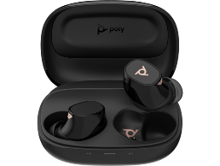
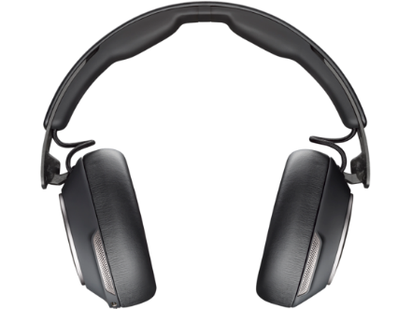
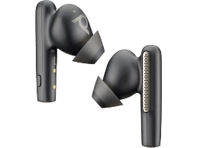
Headphones and Earbuds
Voyager Free 60 and 20
Surround 80 and 85 headphones
Incredible comfort
Discreet wearing style
True wireless and reliable connectivity to PC or mobile device
Long lasting battery
All-day comfort
Amazing noise blocking technology
HP Confidential. For use by HP or Partner with Customers under HP CDA only

Slide 21
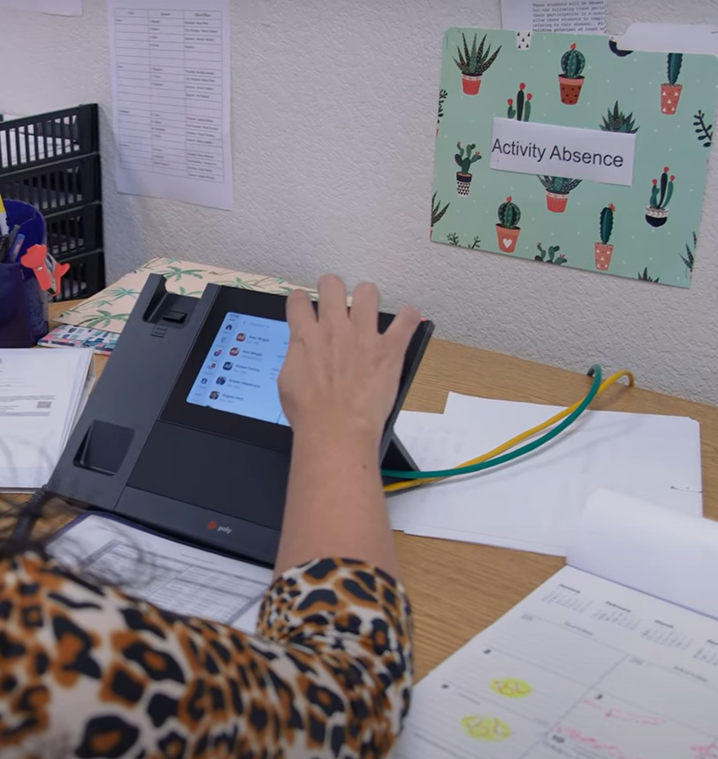
Phones for Campus
Phones for common areas in buildings. HP Poly offers a full line of handsets that can be used.
Integration into leading service providers such as Zoom, Microsoft Teams and more allow for ease of integration into the campus.
Administrators, instructors and others have immediate access to communicate inside or outside the organization.
Additional measures can be programmed to allow for immediate “lock-down” protocols enabled directly from the phone when used with providers such as Zoom.
HP Confidential. For use by HP or Partner with Customers under HP CDA only

Slide 22

Safety
HP Poly Phones when connected with compatible service providers offer:
Silent Panic Alarms:
The core requirement is the installation of silent panic alarms that immediately notify law enforcement during emergencies. Location of phone can also be sent for more accurate response.
Direct Connection to 911:
Alarms are designed to bypass traditional phone lines and directly connect to dispatch centers for faster response times, according to Alertus Technologies.
HP Confidential. For use by HP or Partner with Customers under HP CDA only

Slide 23
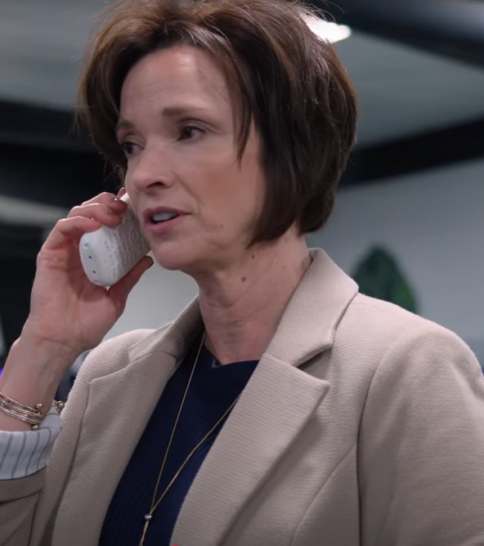
Mobility
HP Poly Rove provides educators and administrators the ability to easily move about campus with immediate connection to critical services.
Integration in Zoom and other SIP based phone systems allow for quick one touch dial.
HP Confidential. For use by HP or Partner with Customers under HP CDA only
Notes:
Phones for Indoor/Campus Mobility
Frost found that:
One-third of organizations state DECT or VoWLAN phones are a “must have,” and another 50% would like to have them
Additionally, 40% of organizations plan to equip their frontline workers with DECT or Voice over Wireless LAN phones

Slide 24
Implementation in Higher Education
Notes:
Implementing HP Poly solutions in K-12 education requires careful planning and support to ensure a smooth transition and effective use of technology.

Slide 25

Cornell University and Queen’s College
Generating revenue by increasing enrollment
  CHALLENGE
Limited candidate pool—classes only offered on primary campuses
  SOLUTION
Joint Executive MBA program supported by a distributed video collaboration network offering face-to-face, interactive instruction
  BENEFITS
Candidate pool expanded to 23 cities in 4 countries, 160 new students in program
Millions of dollars of new revenue
No incremental facilities or staff
Scalable infrastructure to accommodate program growth
“Students find collaborating across cultures helps them view problems in new ways. It’s only by conducting these classes over video that this happens”
Stephen Demmings
Video Conferencing Manager, Cornell University
HP Confidential. For use by HP or Partner with Customers under HP CDA only.
Notes:
In a growing competitive landscape, Universities are constantly battling for students. Cornell and Queens Universities partnered together to offer an executive MBA program greatly expanding the candidate pool. This is only made possible through the use of Poly audio and video solutions.

Slide 26
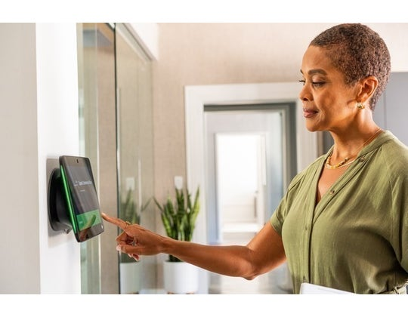
Training and Support for Teachers and Staff
Importance of Ongoing Training
  Ongoing training is essential for teachers and staff to effectively utilize modern technologies in their teaching practices.
Maximizing Effectiveness
  Providing support and resources allows educators to maximize the effectiveness of HP Poly solutions in their classrooms.
Empowering Educators
  Professional development empowers educators by equipping them with the skills necessary to leverage technology for enhanced learning experiences.
HP Confidential. For use by HP or Partner with Customers under HP CDA only
Notes:
Ongoing training and support for teachers and staff are critical for maximizing the effectiveness of HP Poly solutions. Professional development ensures that educators are well-equipped to utilize these technologies.

Slide 27
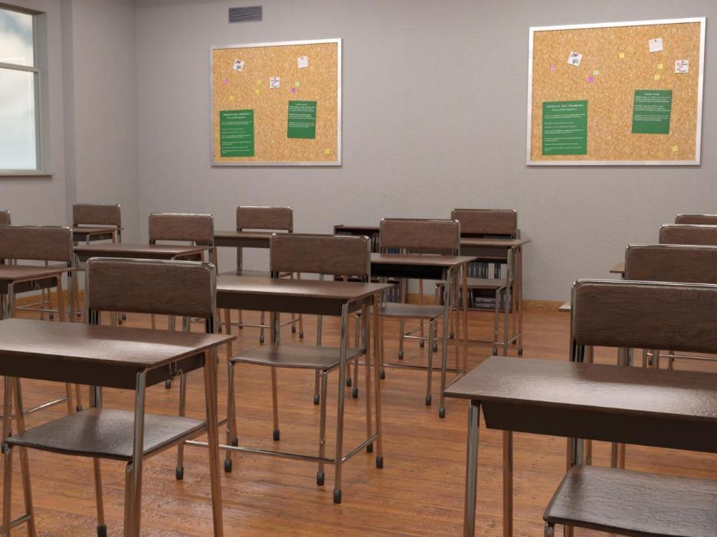
Scalability and Adaptability to Various Learning Environments
Scalable Solutions
  HP Poly's solutions can easily scale according to the size and needs of any learning environment, enhancing educational experiences.
Adaptability in Learning
  These solutions adapt to different teaching styles and learning needs, ensuring effective learning regardless of the environment.
Hybrid Learning Environments
  HP Poly's solutions support hybrid learning, which combines in-person and remote instruction, catering to diverse student needs.
HP Confidential. For use by HP or Partner with Customers under HP CDA only
Notes:
HP Poly's solutions are designed to be scalable and adaptable, making them suitable for a wide range of learning environments, from traditional classrooms to hybrid and remote settings.

Slide 28

Long-Term Benefits for Educational Outcomes
Higher Student Engagement
  Investing in audio and video solutions increases student participation and interest in learning activities.
Improved Communication
  Enhanced audio and video tools facilitate clearer communication between educators and students, leading to better understanding.
Better Learning Experiences
  Quality audio and video solutions create immersive learning environments, enhancing overall educational experiences.
HP Confidential. For use by HP or Partner with Customers under HP CDA only
Notes:
Investing in HP Poly audio and video solutions can lead to long-term improvements in educational outcomes, including higher student engagement, improved communication, and better learning experiences overall.

Slide 29
Thank you.

